Slide 1
Supporting the energy sector’s future wireless communications needs
Justin Moore
Ofcom - Spectrum Group

Slide 2


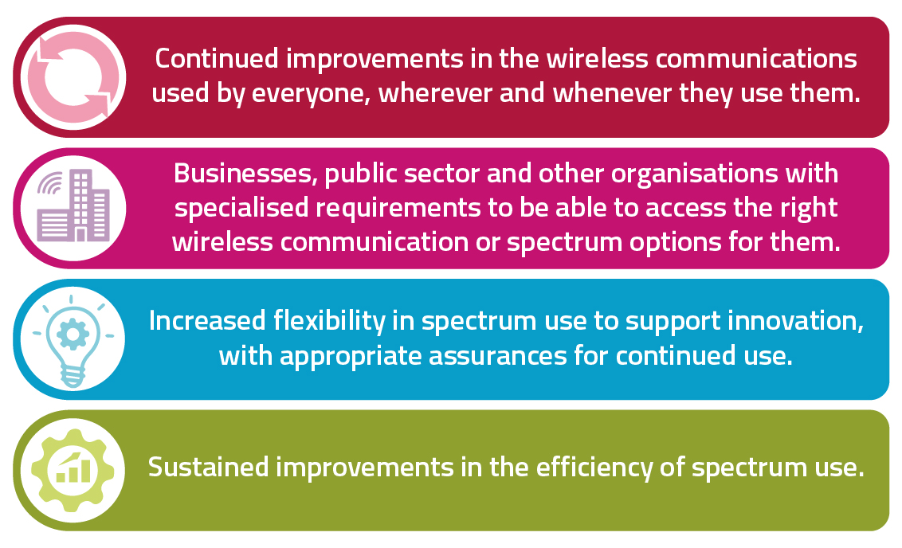
Enabling organisations to get the right wireless comms for their needs is central to our spectrum vision

Slide 3









Profound change in operational comms needs for energy networks and resilience challenges for telecoms networks
Order of magnitude change in operational communications to support energy network transformation
Energy network transformation underpins transition to net zero economy
At the same time as focus on the power resilience of public communication networks
Wide range of stakeholders with a role and interest
Electricity distribution

Slide 4
Committed to ensuring that appropriate access to spectrum isn’t a barrier to comms for energy network transition
The best overall comms solution (for the UK) likely to depend on a range of wider factors
A private wireless network using mobile technology - and would depend on spectrum access
Although nationally clear spectrum is hard to come by we have identified potential spectrum options and their characteristics

Slide 5
Have identified a range of options – all with pros / cons
Below 1 GHz offers better coverage but more constraints
410 MHz
410 – 412 / 420-422 MHz
412–414 MHz / 422–424 MHz (Arqiva)
Licensed for utilities use in Ireland, might be an option for NI
Used for smart metering and Fylingdales radar in UK, less use in NI.
Could seek commercial access from Arqiva
Planned use for utilities in several countries
Significant existing use in UK - ~23k business radio licences, Emergency Services (migrating), scanning telemetry, adj. Fylingdales radar
To minimise cost / disruption, consider 2 x 1.4 MHz
450 MHz
451 – 456 MHz / 461 – 466 MHz
700 MHz
733 - 736 MHz / 788 - 791 MHz
Unused. We have proposed allocation (2 x 3 MHz) to PSNI in NI
Interference risk from mobile base stations in adjacent frequencies – nature of risk and potential mitigations in consultation

Slide 6
Above 1 GHz - Lower coverage but potentially greater availability
1900 MHz
(1900-1920)
Unused. Rail interest in future use of 190-1910 MHz
Plan to consult on a proposal to revoke. Potential full availability from 2028 subject to outcome of consultation
Additional base station sites needed to achieve wide coverage
Shared access
1800 MHz (2 x 3.3 MHz)
3.8-4.2 GHz
Already available – site by site coordination
Might suit hybrid solution with mix of technologies (e.g. fibre, mobile tech, satellite) with location by location decision on what is best option

Slide 7
Next steps
We will continue to engage with utility stakeholders and with Government and Ofgem
We will further develop our thinking on these issues - currently aiming to provide an update Q1 2023/24

